Slide 1
OPENING THESIS
Smartphone pricing is explainable when the model focuses on brand, camera, memory, and RAM.
A notebook-backed business story built from project4.ipynb, with exact graph outputs and metrics preserved.
INSIGHT
The story is not just prediction; it is which product signals deserve pricing attention.
531 cleaned listings
187 unique models
531 cleaned listings
187 unique models
BUSINESS MOVE
Rs 16,305.77 mean price
R2 0.6156 final model
Use this model as decision support for price bands and product positioning.
Rs 16,305.77 mean price
R2 0.6156 final model
Brand + camera dominate
Memory/RAM refine tiers
AI Lens is weak
Use as decision support
Source: project4.ipynb
01/25

Slide 2
STORY ARC
The analysis moves from catalog cleanup to a business pricing playbook.
The workflow is load data, clean it, explore the market, engineer features, train models, and convert results into recommendations.
INSIGHT
A pricing model is only useful if stakeholders trust the data and understand the drivers.
541 raw rows
10 duplicates removed
541 raw rows
10 duplicates removed
BUSINESS MOVE
424 train / 107 test
7 models compared
Present recommendations after proving data quality and driver logic.
424 train / 107 test
7 models compared
Data -> Evidence
Evidence -> Drivers
Load
>
Clean
>
Explore
>
Engineer
>
Model
>
Recommend
Drivers -> Model
Model -> Action
Source: project4.ipynb
02/25

Slide 3
DATA TRUST
The dataset is usable because missing values are zero and major quality issues were treated.
The notebook reports 0 missing values in every column, removes 10 duplicate rows, and replaces 17 unrealistic height values with median 16.76 cm.
INSIGHT
The first business risk is not model choice; it is catalog reliability.
0 missing values
10 duplicate rows removed
0 missing values
10 duplicate rows removed
BUSINESS MOVE
17 height values corrected
16.76 cm median height
Keep data cleaning as a required step before pricing automation.
17 height values corrected
16.76 cm median height
Data -> Evidence
Evidence -> Drivers
Drivers -> Model
Model -> Action
Source: project4.ipynb
03/25

Slide 4
MARKET BASELINE
The market is budget-to-mid heavy, with a few premium devices stretching the price range.
Prices range from Rs 920 to Rs 80,999. Median price is Rs 13,999 and mean price is Rs 16,305.77.
INSIGHT
Most decisions should optimize the budget/mid-range cluster, not chase flagship exceptions.
Rs 13,999 median price
Rs 16,305.77 mean price
Rs 13,999 median price
Rs 16,305.77 mean price
BUSINESS MOVE
Rs 920 minimum
Rs 80,999 maximum
Separate budget, mid-range, and flagship pricing rules.
Rs 920 minimum
Rs 80,999 maximum
Data -> Evidence
Evidence -> Drivers
Drivers -> Model
Model -> Action
Source: project4.ipynb
04/25

Slide 5
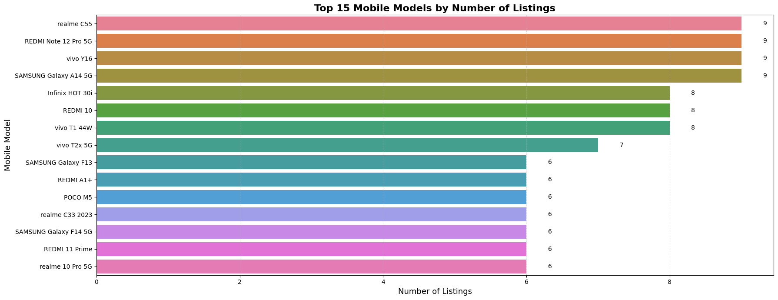
MODEL MIX
High-frequency models create the clearest benchmark set for price comparison.
realme C55, REDMI Note 12 Pro 5G, vivo Y16, and Samsung Galaxy A14 5G each appear 9 times.
INSIGHT
The strongest comparison groups come from repeated listings, not one-off devices.
BUSINESS MOVE
Benchmark pricing first on high-frequency models, then extend rules to sparse models.
Top models: 9 listings each
realme C55 is most frequent
187 unique models
Use repeat listings as benchmarks
Source: project4.ipynb
05/25

Slide 6
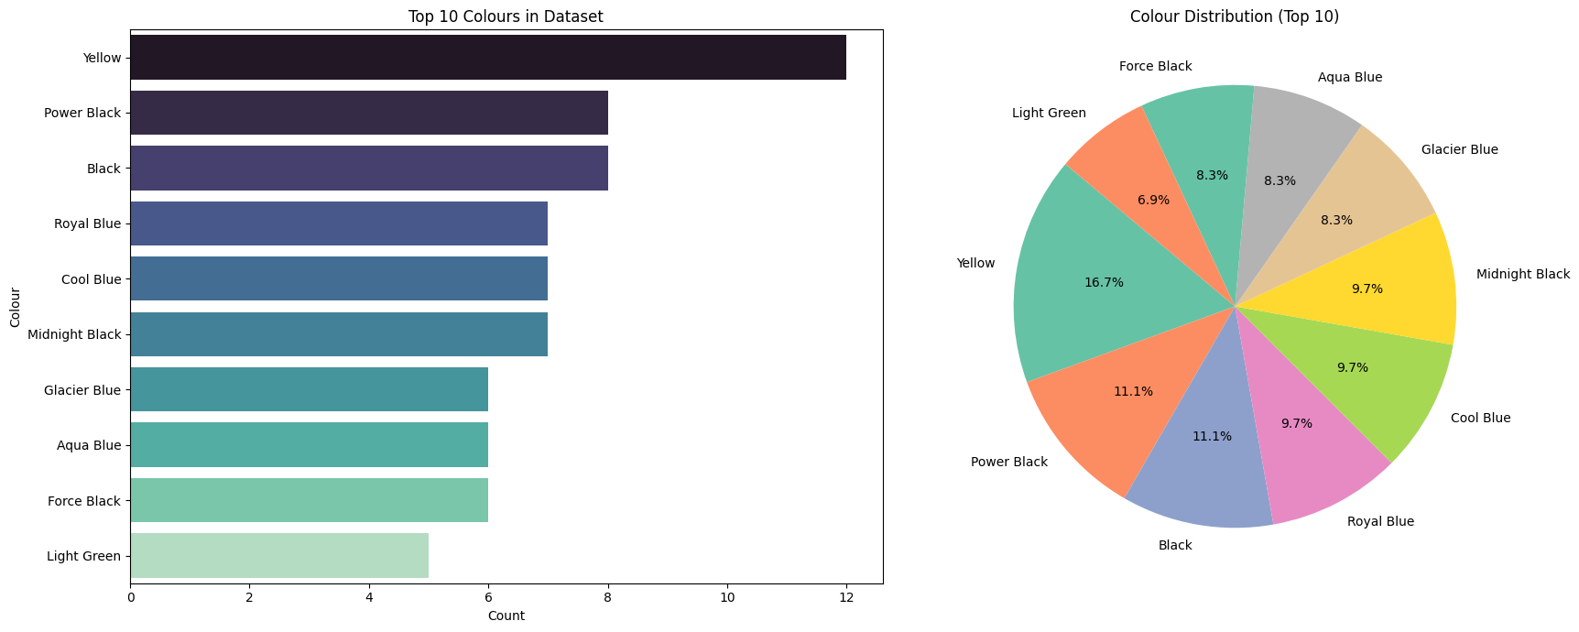
COLOR DATA
Color is too fragmented to be trusted as a direct pricing driver.
The notebook shows 275 unique color labels compared with 187 unique models; Yellow appears 12 times.
INSIGHT
Color labels likely mix real variety with naming inconsistency.
BUSINESS MOVE
Standardize colors into families before using them in business rules.
275 unique colors
Yellow: 12 listings
Color count > model count
Standardization needed
Source: project4.ipynb
06/25

Slide 7
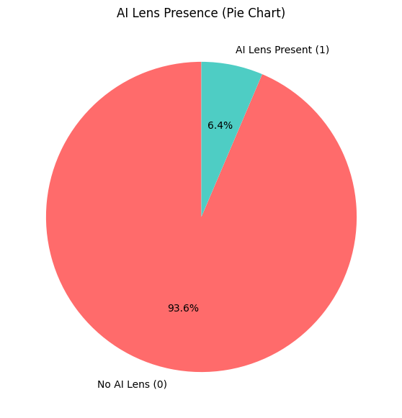
AI LENS
AI Lens is rare, so it should not lead the pricing narrative.
Only 6.4% of smartphones have AI Lens, while 93.6% do not.
INSIGHT
A rare feature may help marketing copy, but it cannot explain mainstream price movement.
BUSINESS MOVE
Treat AI Lens as an add-on signal, not a pricing pillar.
93.6% no AI Lens
6.4% AI Lens present
Imbalanced feature
Low final importance
Source: project4.ipynb
07/25

Slide 8
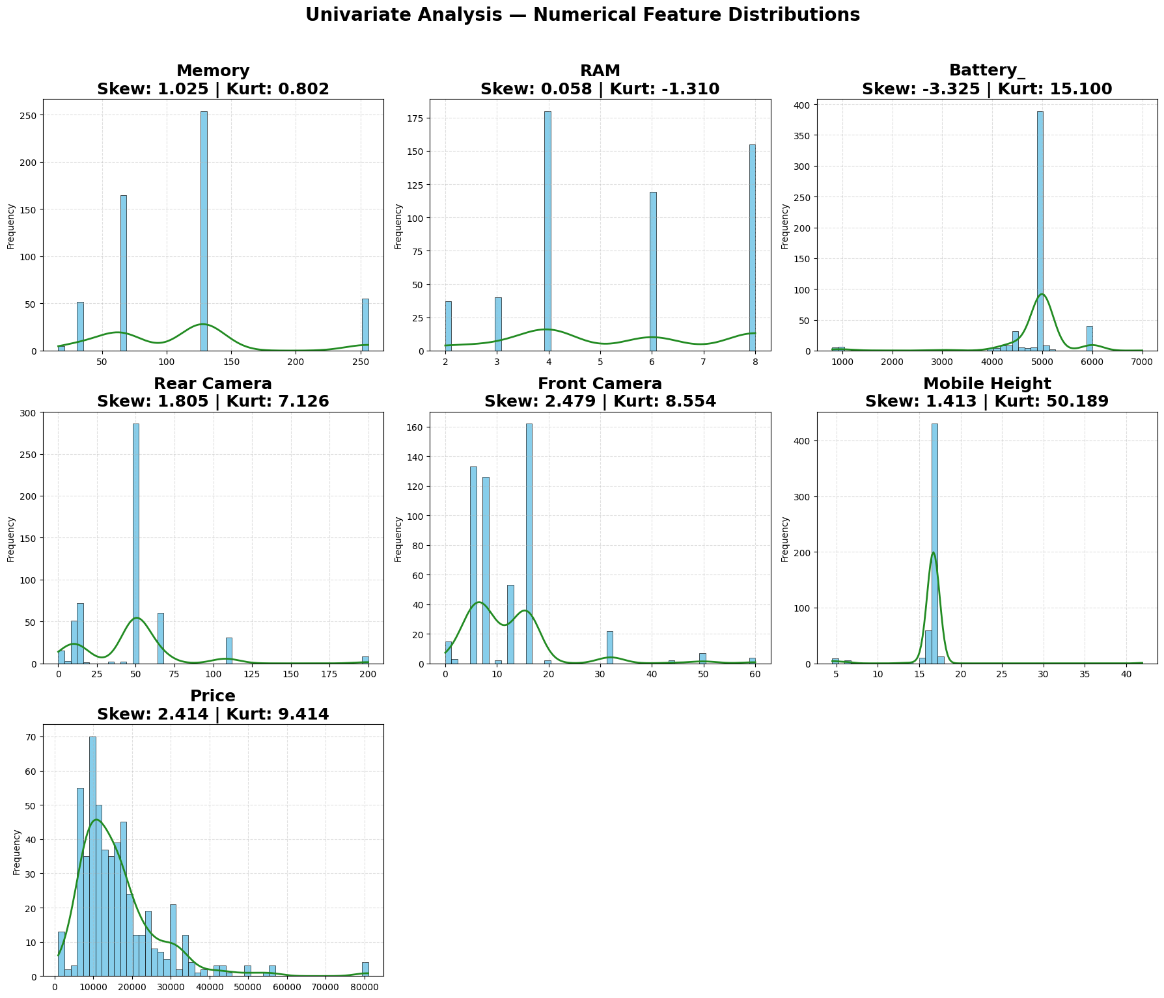
SPEC CENTER
The typical product is mid-spec, not premium.
Distributions cluster around 64/128 GB storage, 4/6 GB RAM, 5,000 mAh battery, and budget-to-mid price levels.
INSIGHT
The market center tells us where pricing recommendations will be most useful.
BUSINESS MOVE
Build recommendations around the dominant mid-spec segment first.
64/128 GB cluster
4/6 GB RAM common
5,000 mAh common
Budget-mid concentration
Source: project4.ipynb
08/25

Slide 9
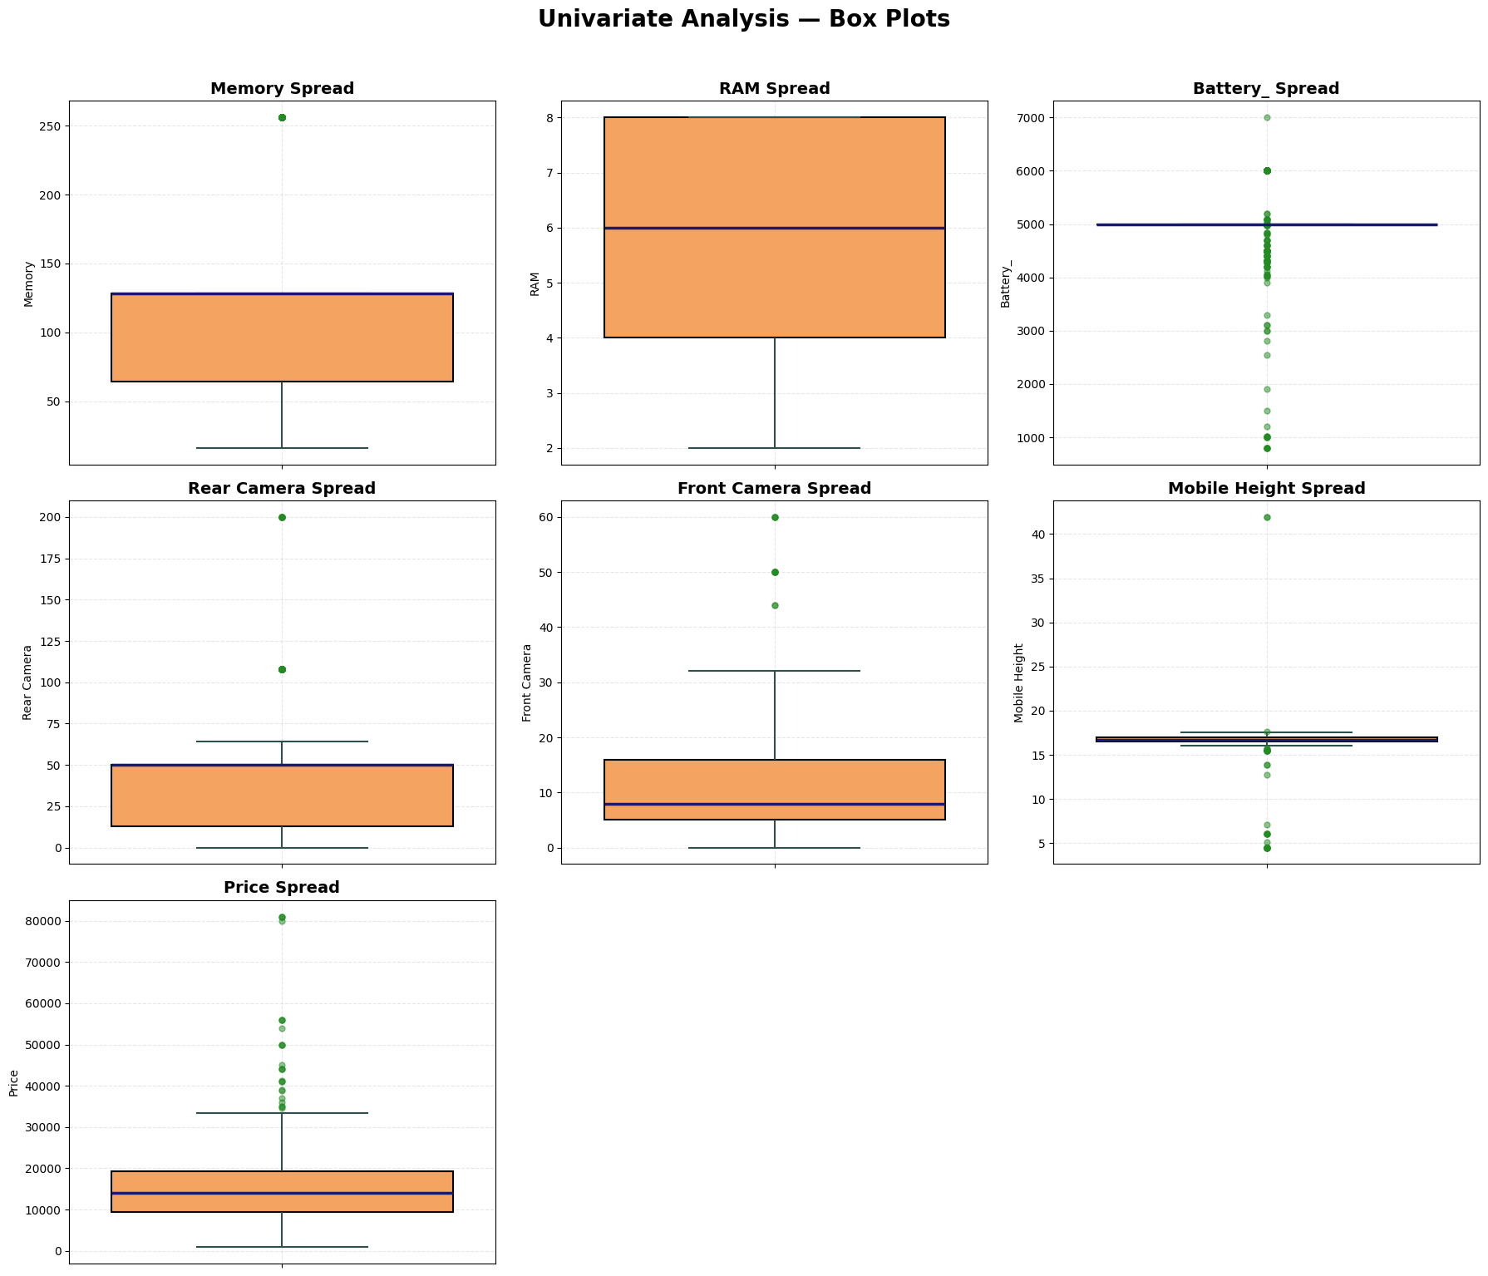
OUTLIER RISK
Battery and memory create the biggest outlier pressure in the dataset.
IQR outliers are Memory 55, RAM 0, Battery 148, Rear Camera 39, Front Camera 13, Mobile Height 32, Price 25.
INSIGHT
Outliers are not noise only; they show where product catalog rules need controls.
BUSINESS MOVE
Audit battery, memory, camera, and price extremes before deployment.
Battery outliers: 148
Memory outliers: 55
RAM outliers: 0
Price outliers: 25
Source: project4.ipynb
09/25

Slide 10
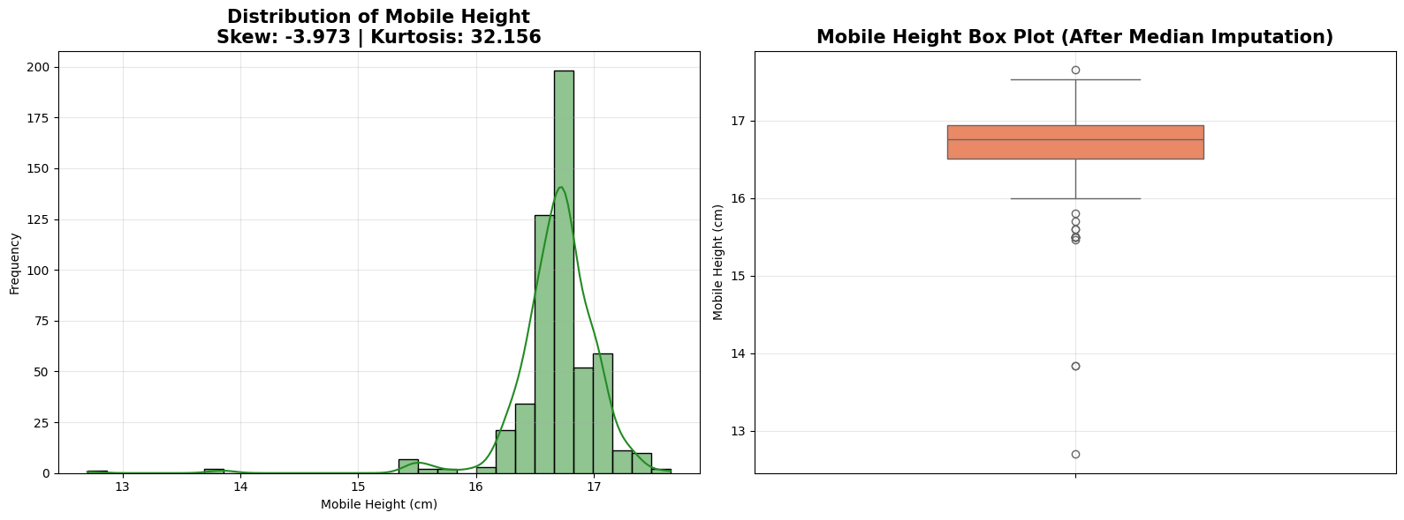
HEIGHT CLEANUP
Height became realistic only after median imputation.
After correcting 17 values, mobile height ranges from 12.70 cm to 17.65 cm; mean is 16.68 cm and median is 16.76 cm.
INSIGHT
This is a data-quality win, but height still remains a weak pricing signal.
BUSINESS MOVE
Use height for product description, not primary price setting.
17 values replaced
12.70-17.65 cm range
16.68 cm mean
16.76 cm median
Source: project4.ipynb
10/25

Slide 11
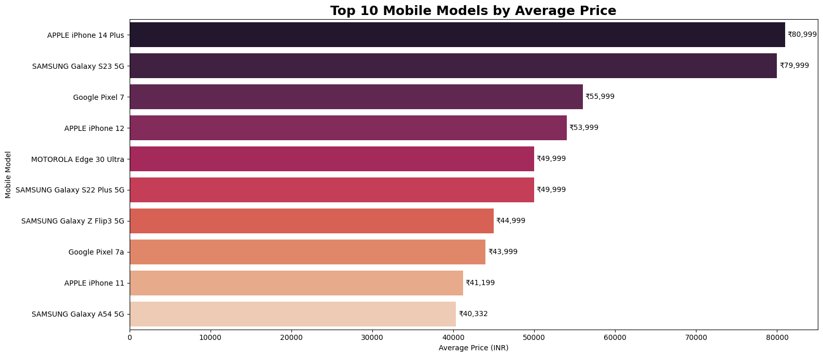
PREMIUM ANCHOR
Flagship Apple and Samsung devices define the price ceiling, not the average market.
APPLE iPhone 14 Plus averages Rs 80,999; SAMSUNG Galaxy S23 5G averages Rs 79,999.
INSIGHT
Premium anchors are useful for framing, but they can distort budget pricing if mixed with all models.
BUSINESS MOVE
Keep flagship pricing rules separate from mass-market phones.
Apple iPhone 14 Plus: Rs 80,999
Samsung S23 5G: Rs 79,999
Premium anchor logic
Separate flagship tier
Source: project4.ipynb
11/25

Slide 12
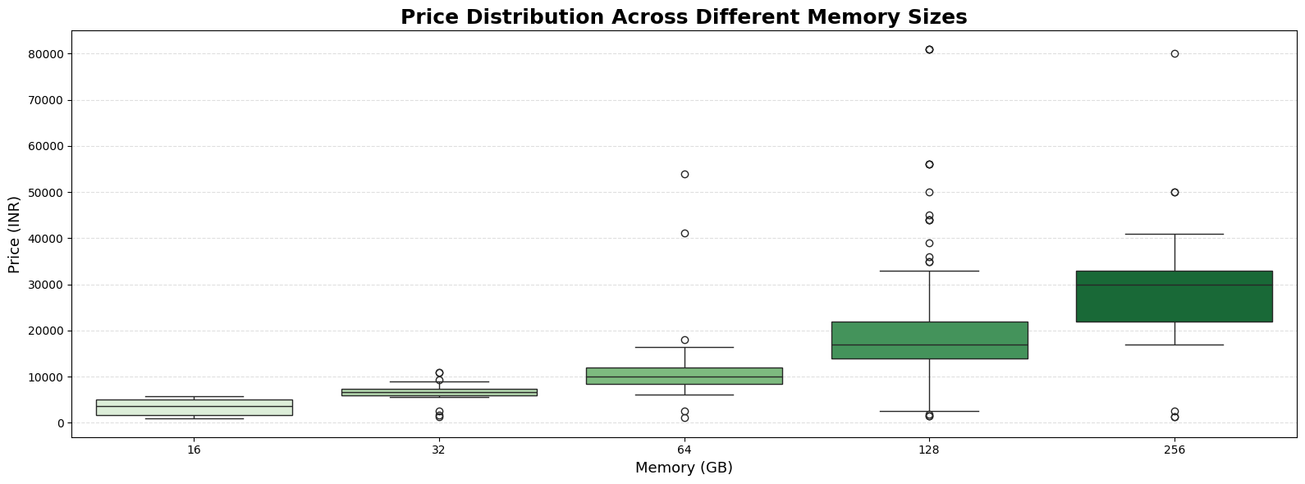
STORAGE LEVER
Storage works as a practical upsell lever.
Memory ranges from 16 GB to 256 GB across 5 variants, and higher memory generally commands higher prices.
INSIGHT
Storage is easy for customers to understand and easy for businesses to price.
BUSINESS MOVE
Create clear 64/128/256 GB price ladders.
16-256 GB range
5 memory variants
128 GB median storage
Storage supports upsell
Source: project4.ipynb
12/25

Slide 13
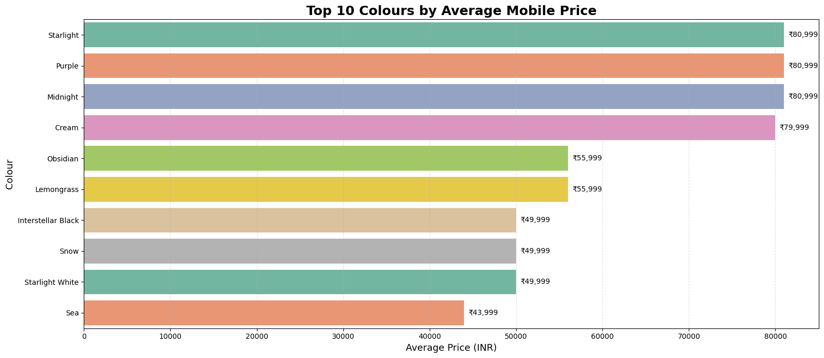
COLOR PREMIUM
Expensive color labels should be treated as model effects, not color magic.
The chart ranks top colors by average price across 275 unique color labels.
INSIGHT
A premium color label may simply belong to a premium device.
BUSINESS MOVE
Do not price up colors until model and spec effects are controlled.
Top 10 color labels ranked
275 color labels
Confounding risk
Group before modeling
Source: project4.ipynb
13/25

Slide 14
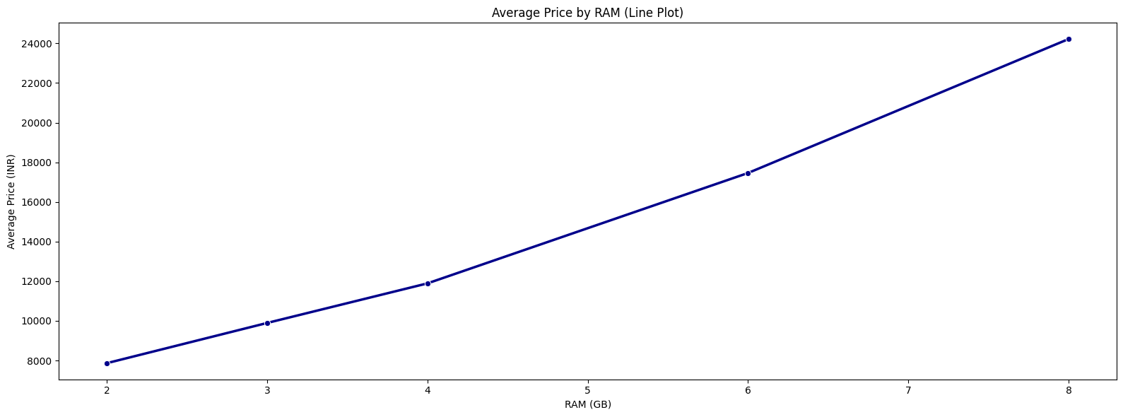
RAM LADDER
RAM supports the performance-tier story with a clear positive price relationship.
RAM has a notebook correlation with Price of 0.529474.
INSIGHT
RAM helps explain why performance variants command more price.
BUSINESS MOVE
Pair RAM with memory and camera in premium bundles.
Correlation with Price: 0.529474
RAM mean: 5.40 GB
Max RAM: 8 GB
Tier by 6GB/8GB
Source: project4.ipynb
14/25

Slide 15
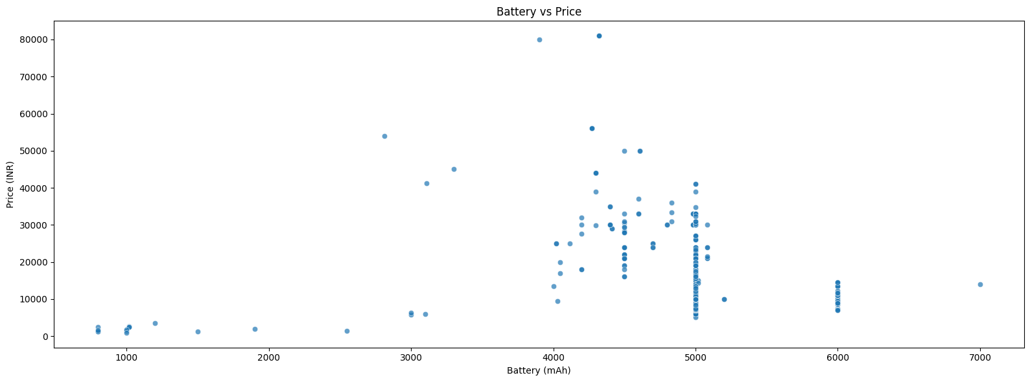
BATTERY VALUE
Battery is a value message, not a strong price driver.
Battery ranges from 800 mAh to 7,000 mAh, but correlation with Price is -0.046250.
INSIGHT
Customers care about battery, but the model does not show it as a premium price lever.
BUSINESS MOVE
Use battery to defend value propositions, not to justify large premiums.
800-7,000 mAh range
Mean: 4,873.88 mAh
Correlation: -0.046250
Value messaging
Source: project4.ipynb
15/25

Slide 16
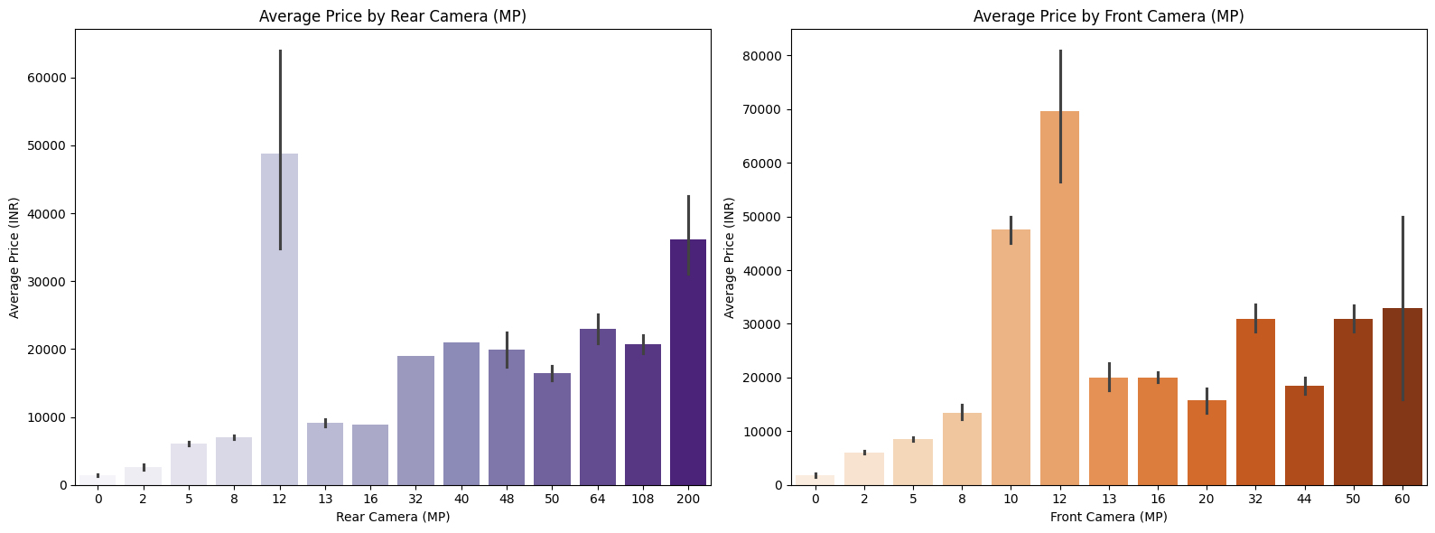
CAMERA POWER
Camera capability is the strongest hardware story after brand.
The model later assigns Total_Camera_MP a 31.50% feature contribution.
INSIGHT
Camera specs are both visible to customers and powerful in the model.
BUSINESS MOVE
Make camera capability a core premium bundle signal.
Total_Camera_MP: 31.50%
Rear camera correlation: 0.406784
Front camera correlation: 0.529013
Validate 0MP values
Source: project4.ipynb
16/25

Slide 17
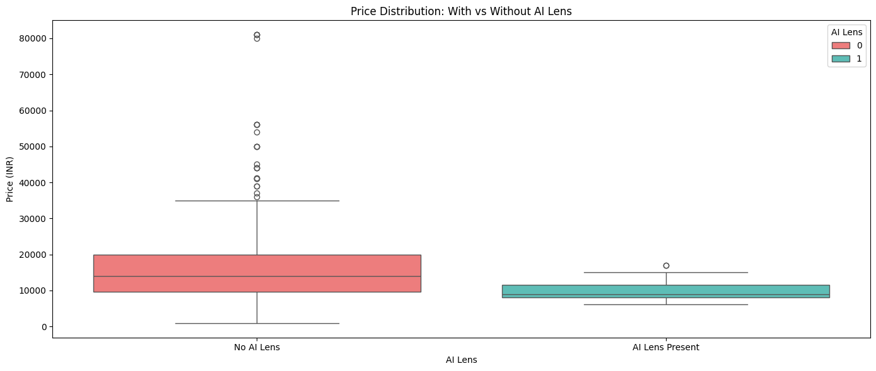
AI LENS LIMIT
AI Lens almost disappears once stronger pricing drivers are included.
AI Lens contributes only 0.11% in feature importance.
INSIGHT
The feature sounds modern, but the evidence says it is not a major price driver here.
BUSINESS MOVE
Market AI Lens as support copy only.
AI Lens importance: 0.11%
Presence: 6.4%
Weak price signal
Do not over-price
Source: project4.ipynb
17/25

Slide 18
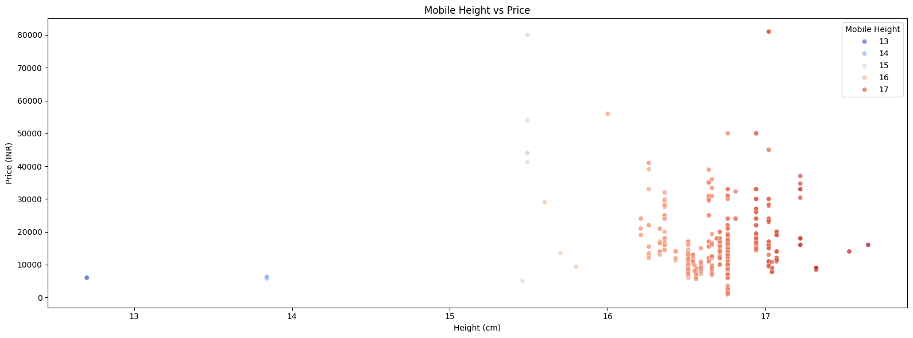
FORM FACTOR
Mobile height is descriptive, not strategic for pricing.
Mobile Height correlation with Price is -0.043954 after cleaning.
INSIGHT
The cleaned field is useful for catalog quality but weak for commercial decisions.
BUSINESS MOVE
Keep height as metadata and rely on stronger signals for pricing.
Correlation: -0.043954
Cleaned range: 12.70-17.65 cm
Mean: 16.68 cm
Metadata role
Source: project4.ipynb
18/25

Slide 19
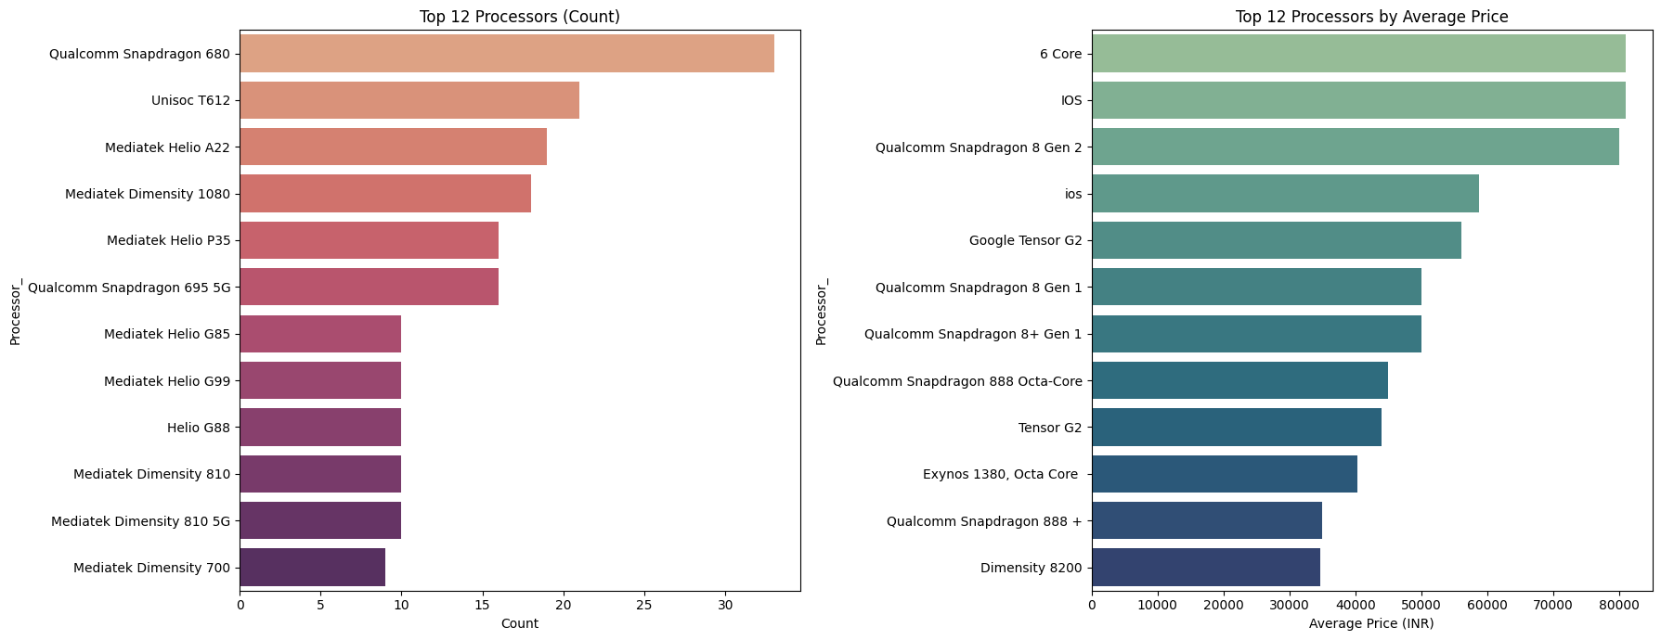
PROCESSOR SIGNAL
Processor variety needs simplification before it can guide business decisions.
The dataset has 123 unique processors; Processor_category contributes 1.93% importance.
INSIGHT
Raw processor names are too fragmented for simple pricing rules.
BUSINESS MOVE
Use processor categories for tier labels, not as a dominant price driver.
123 unique processors
Mediatek: 280
Qualcomm: 129
Importance: 1.93%
Source: project4.ipynb
19/25

Slide 20
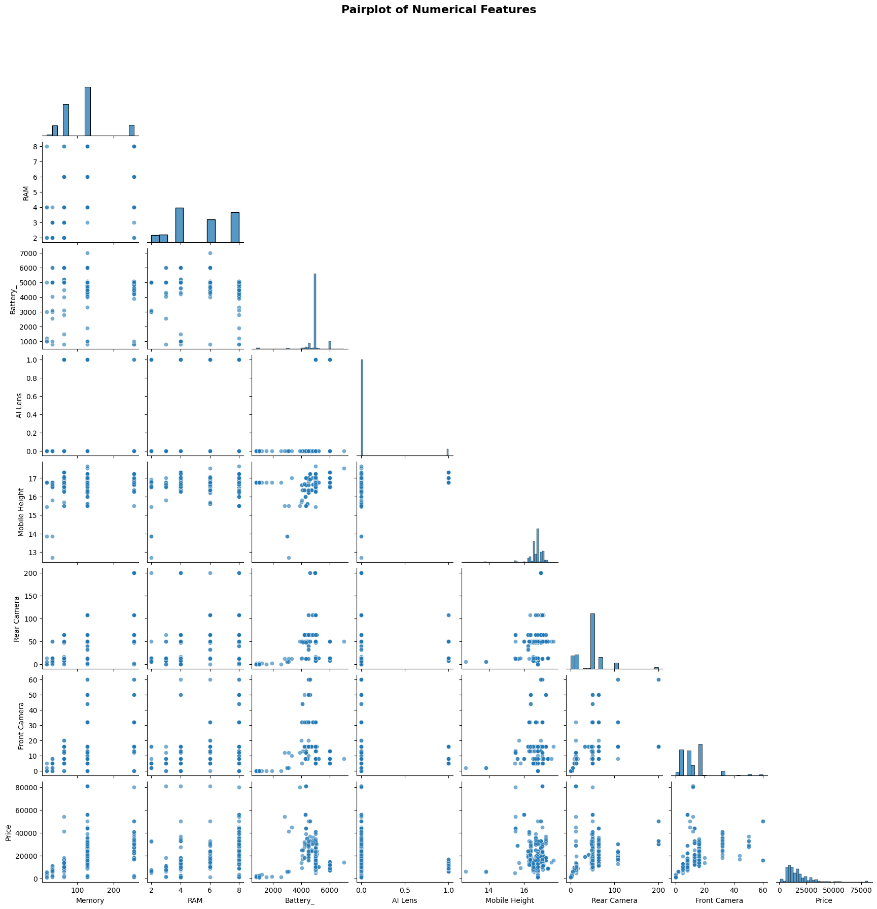
NONLINEARITY
Price behavior is too nonlinear for one-factor rules.
The pairplot shows relationships across Memory, RAM, Battery, AI Lens, Mobile Height, cameras, and Price.
INSIGHT
A simple rule like higher battery equals higher price would miss the real interactions.
BUSINESS MOVE
Use tree-based models and explain them with feature importance.
Multiple feature interactions
Pairplot supports modeling
Avoid single-variable rules
Use tree-based methods
Source: project4.ipynb
20/25

Slide 21
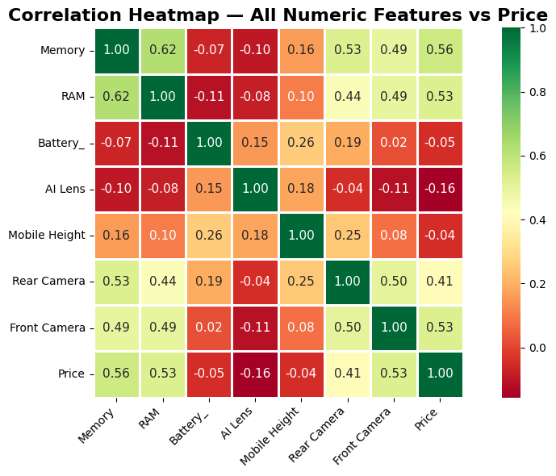
CORRELATION PROOF
Memory, RAM, and cameras are the most explainable numeric drivers.
Correlation with Price: Memory 0.563535, RAM 0.529474, Front Camera 0.529013, Rear Camera 0.406784.
INSIGHT
These are the variables stakeholders can understand and act on.
BUSINESS MOVE
Use them as the explanation layer for price recommendations.
Memory: 0.563535
RAM: 0.529474
Front Camera: 0.529013
Rear Camera: 0.406784
Source: project4.ipynb
21/25

Slide 22
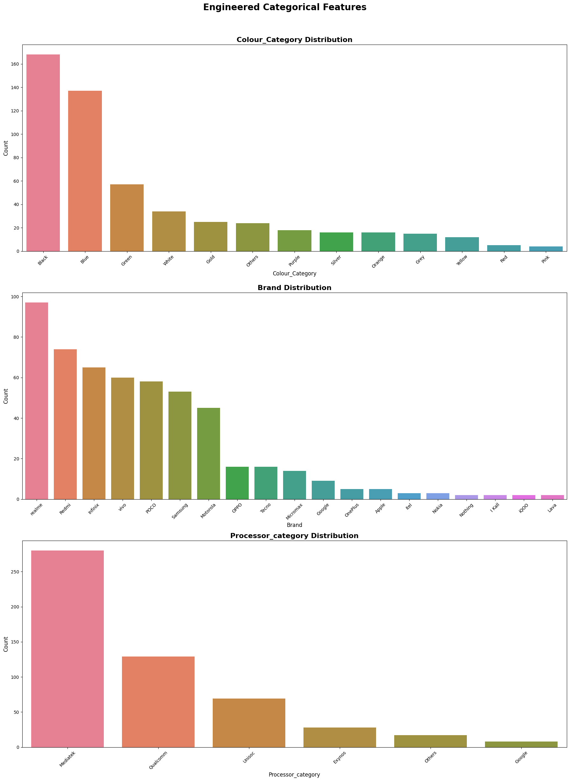
FEATURE BRIDGE
Feature engineering turns messy product attributes into business-ready signals.
The notebook creates Total_Camera_MP, Brand, Colour_Category, and Processor_category.
INSIGHT
The engineered variables connect raw catalog data to commercial decisioning.
BUSINESS MOVE
Keep engineered fields in the pricing pipeline.
Brand: realme 97, Redmi 74
Infinix 65, vivo 60
Processor: Mediatek 280
Qualcomm 129
Source: project4.ipynb
22/25

Slide 23
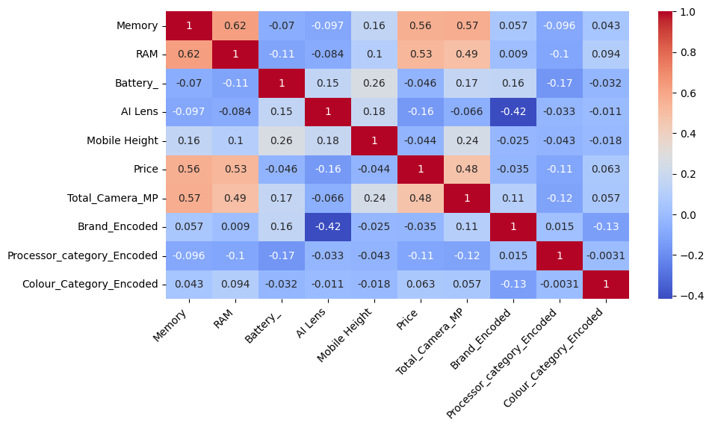
MODELING READINESS
The model is trained on a clean encoded feature set, not raw text columns.
The transformed dataset contains 531 records and 10 features; 9 feature columns are scaled.
INSIGHT
Encoding and scaling make the model repeatable and auditable.
BUSINESS MOVE
Document transformations so future predictions are reproducible.
531 records
10 transformed features
9 scaled feature columns
Label encoding applied
Source: project4.ipynb
23/25

Slide 24
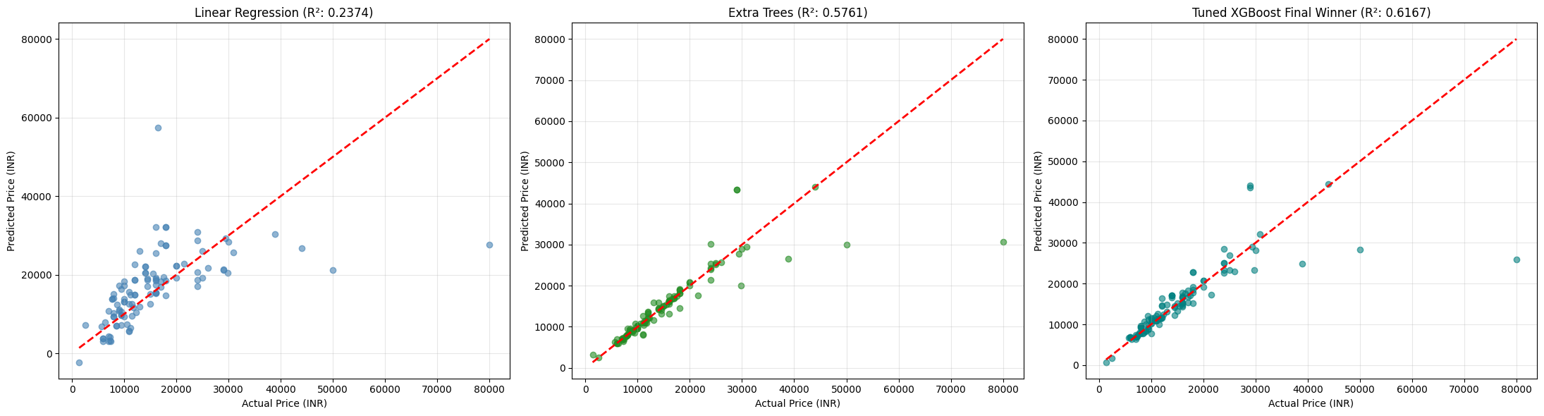
MODEL RESULT
Regularized XGBoost is useful, but the remaining error means human review still matters.
Strictly regularized XGBoost: MAE Rs 2,304.50, RMSE Rs 6,366.31, R2 0.6156; train/test gap 0.3717.
INSIGHT
The model is good enough for guidance, not perfect automation.
BUSINESS MOVE
Use predictions as a recommendation layer with review thresholds.
MAE: Rs 2,304.50
RMSE: Rs 6,366.31
R2: 0.6156
83.18% within +-20% error
Source: project4.ipynb
24/25

Slide 25
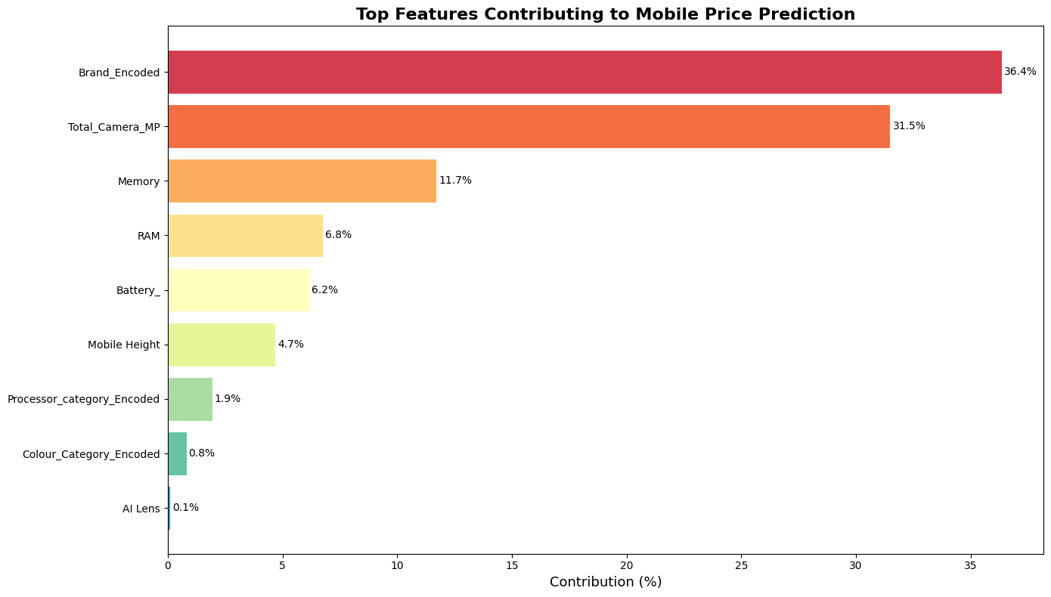
BUSINESS ACTION
The pricing playbook should start with brand and camera, then refine by memory and RAM.
Feature importance: Brand 36.36%, Total_Camera_MP 31.50%, Memory 11.71%, RAM 6.77%, Battery 6.15%, Mobile Height 4.68%.
INSIGHT
Together, brand and camera explain nearly 68% of model importance.
BUSINESS MOVE
Deploy tiered price bands, fix catalog fields, and add market demand data next.
Brand: 36.36%
Total_Camera_MP: 31.50%
Memory: 11.71%
RAM: 6.77%
Source: project4.ipynb
25/25

